Slide 1



PROJECT AQUARIUM
Member:
Lý Minh Trung ITDSIU19023
Trương Thái Ngọc Toàn ITDSIU19057
Nguyễn Đình Thông ITDSIU19018
Lý Minh Khang ITITIU18180

Slide 2
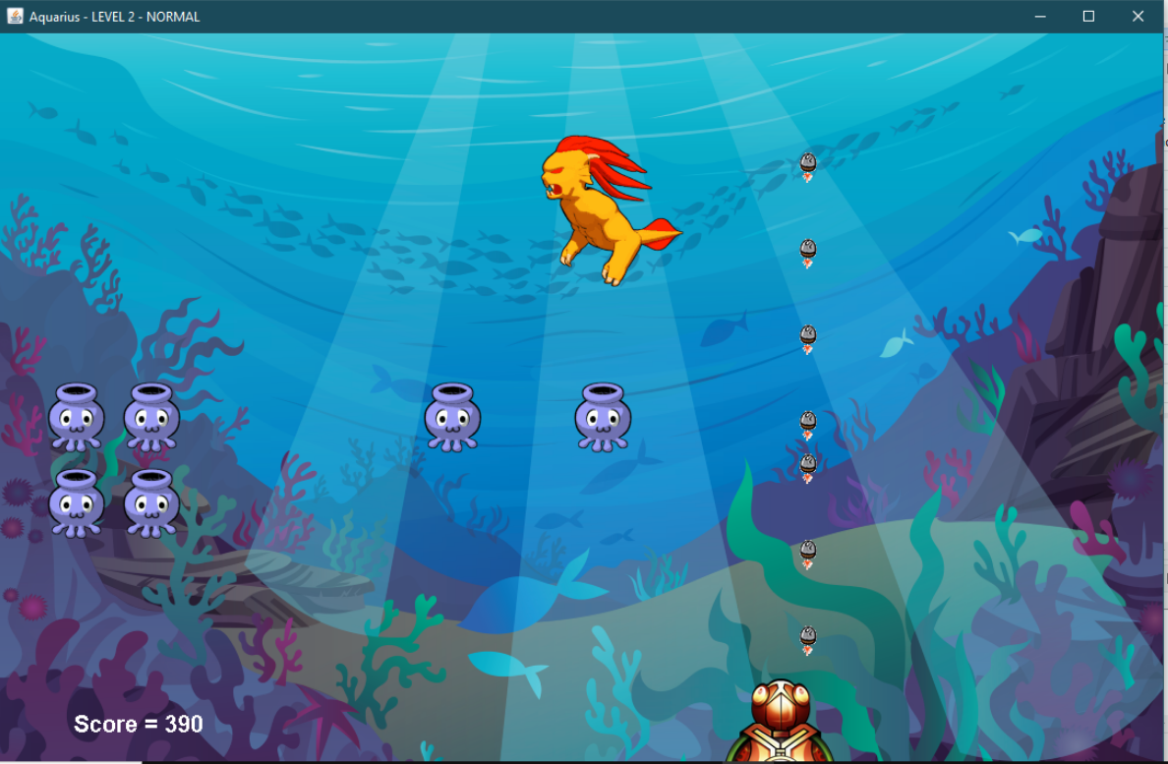

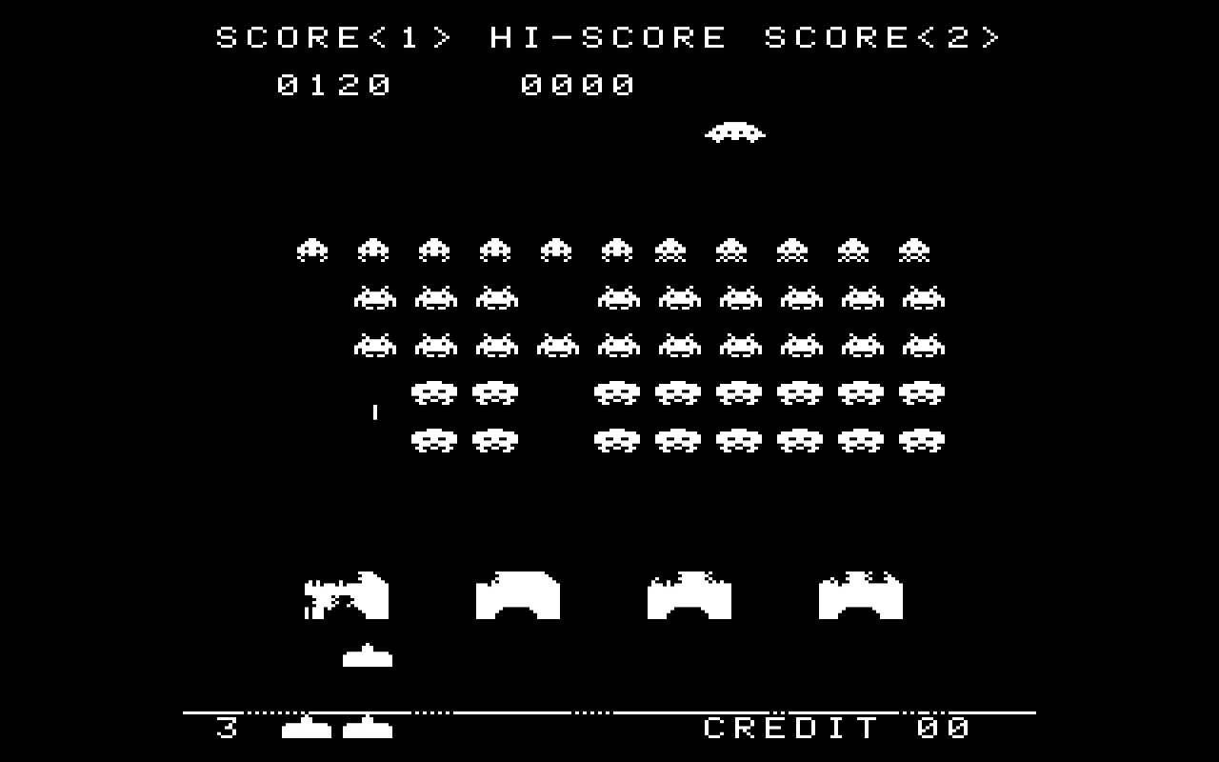





Inspiration from the game “Space Invaders !” and the blue of sea we create a game named “Aquarium”

Slide 3







CONTROL

Slide 4

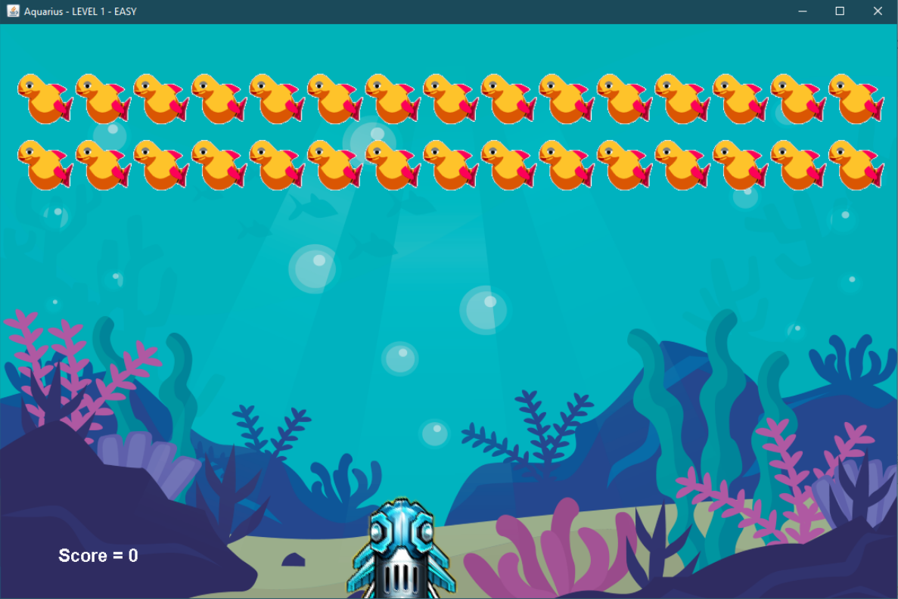
Level 1
Name: Fish
HP : 10
Name : Gun LV1
Dame : 10
MISSON
Kill 30 fish .
Do not let the fish get pass.

Slide 5
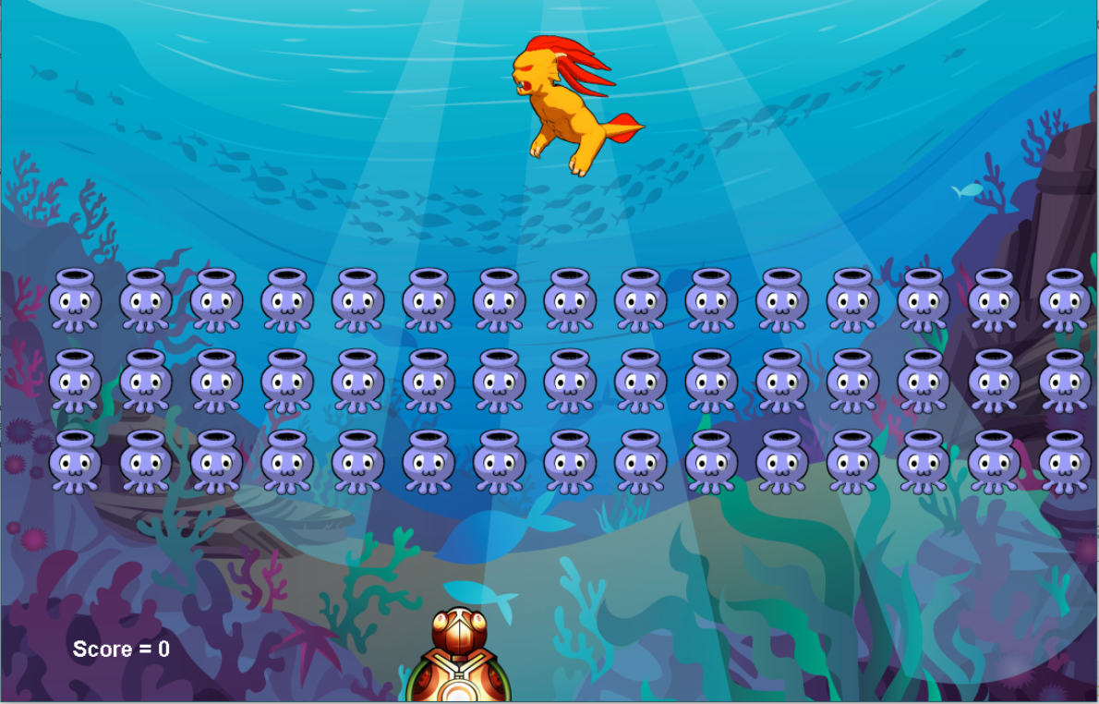
Level 2
Name: Star
HP : 10
Name : Gun LV2
Dame : 10
Name : Balrog HP : 300 Weak point: Head
MISSON
Kill 45 squid to pass.
Kill the boss.
Do not let the fish get pass

Slide 6

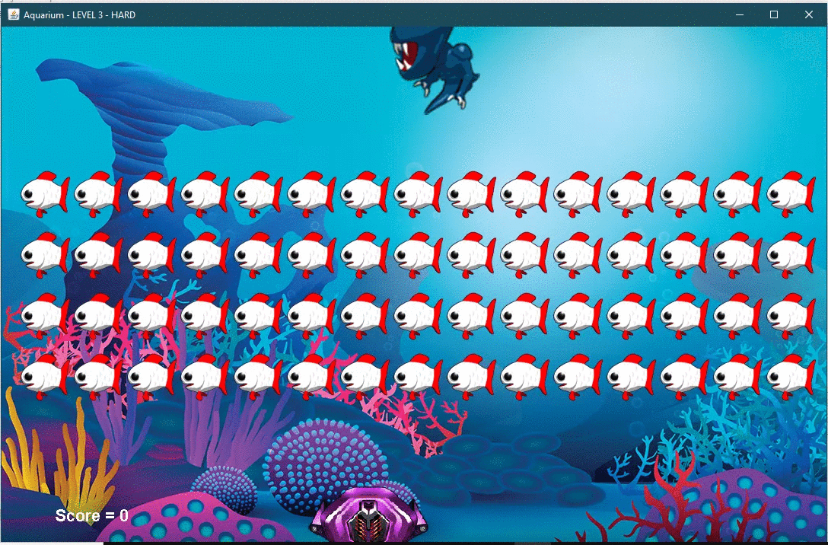

Level 3
Name: Santa
HP : 10
Name : Gun LV3
Dame : 10
Name : MiniS HP : 300 Weak point: Head
MISSON
Kill 60 squid to pass.
Kill the boss.
Do not let the fish get pass

Slide 7

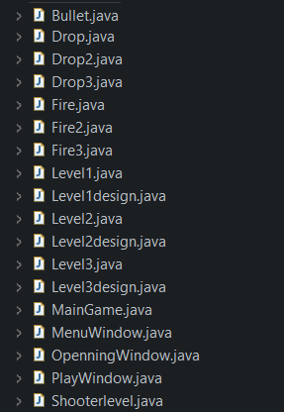
About the code

Slide 8
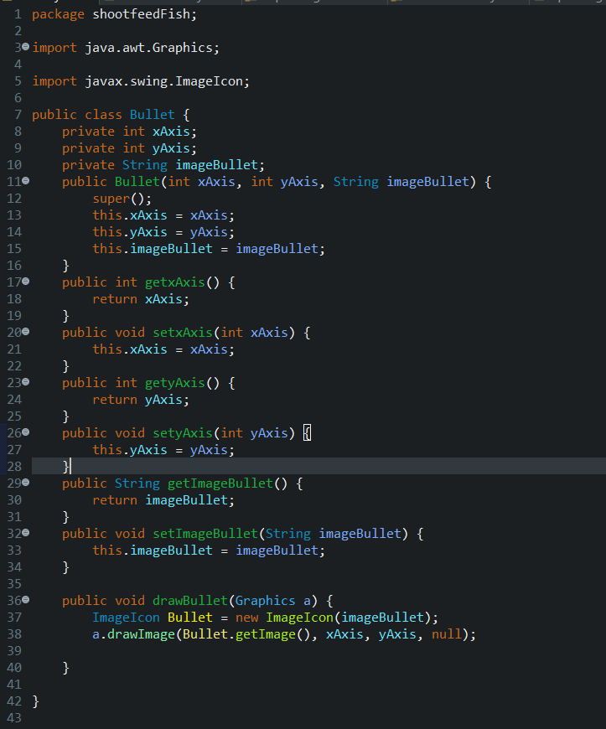

#Bullet
The class declaring and setting some properties of the bullet .

Slide 9
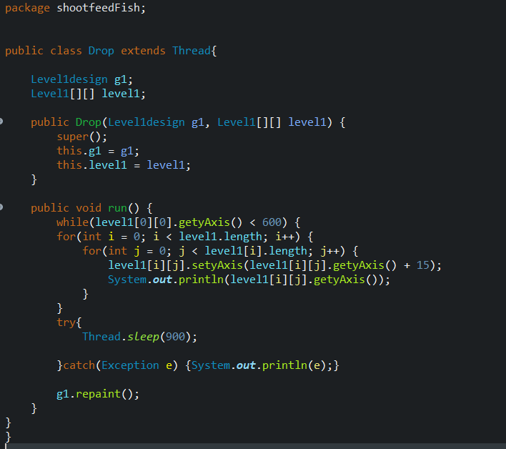
#Drop
classes that are used to make a fish move or drop down.

Slide 10
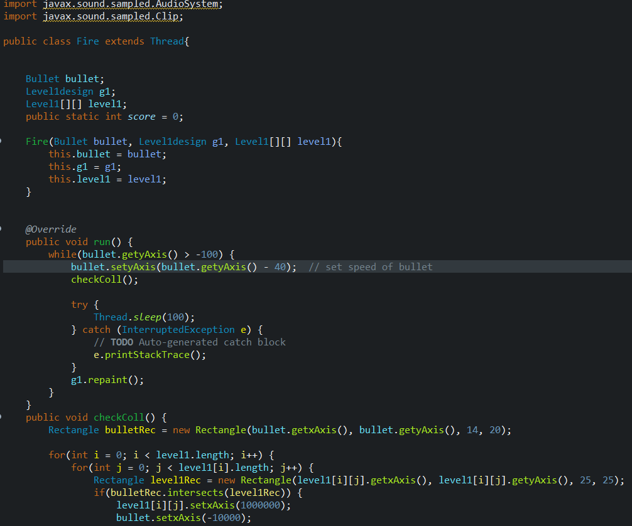
#Fire
Class that are used to make bullets out the gun.
It help the bullet go out off gun at right place and speed

Slide 11
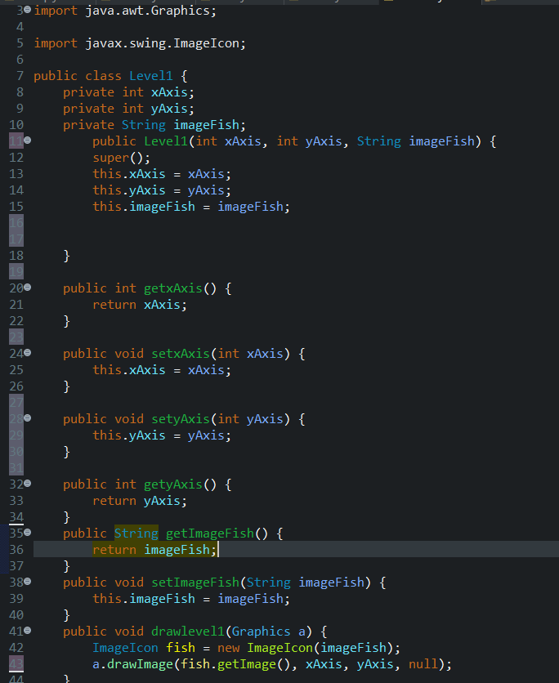
#Level
Class to declare each level
Choose which fish will be our enemy this round

Slide 12
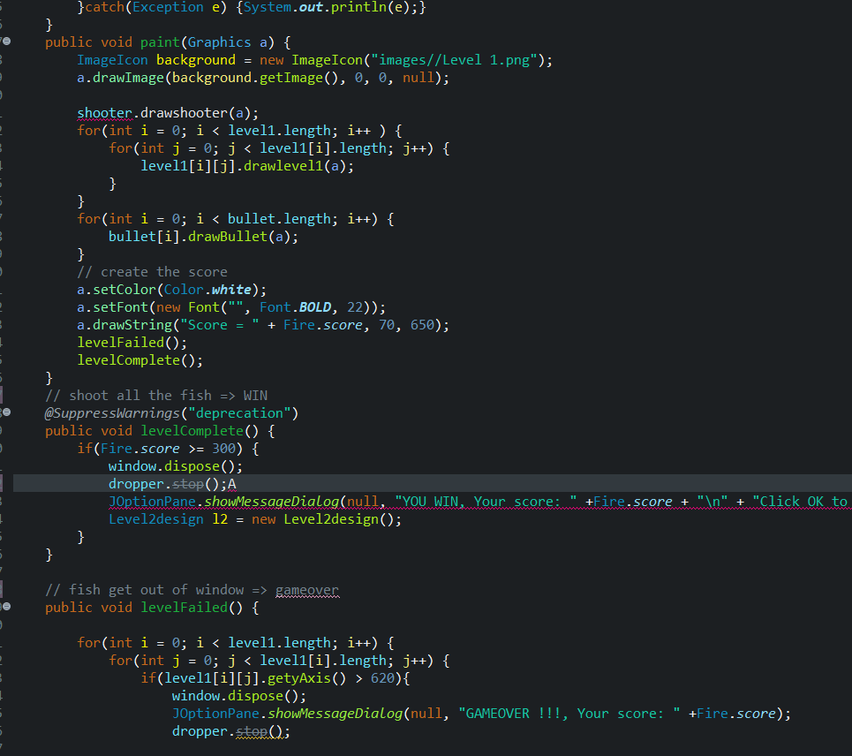
#LevelDesign
The class use to design each level
How many fish, fish hp, boss,…

Slide 13
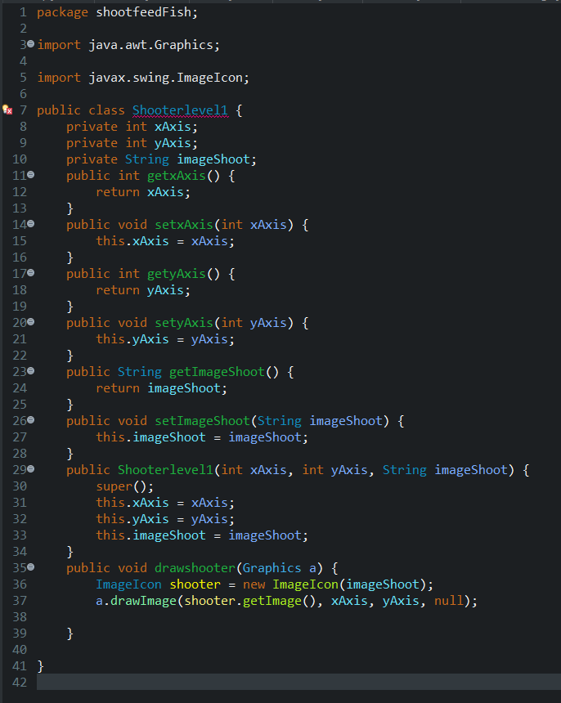
#ShooterLevel
The class use to create the gun.

Slide 14
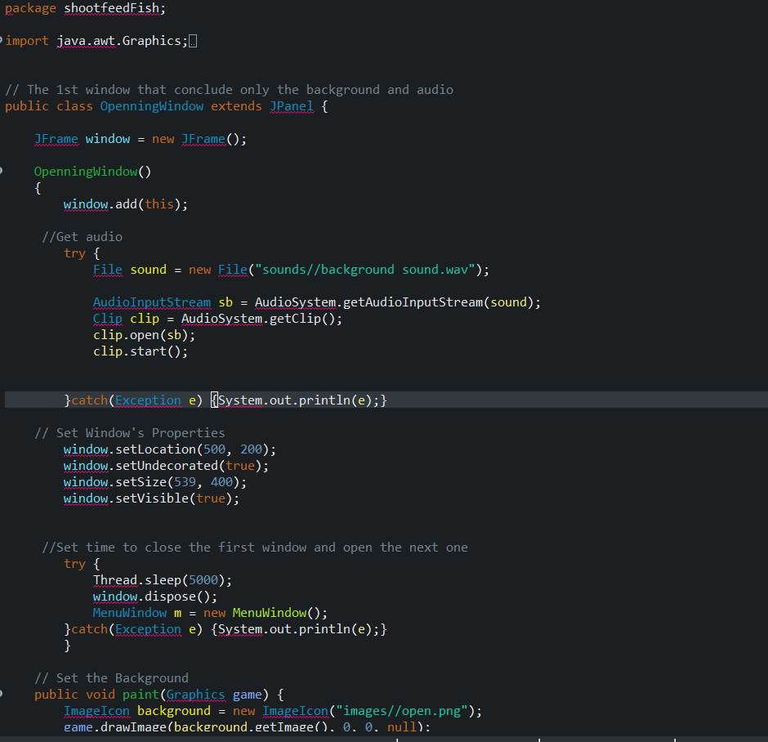

#OpeningWindow
Use to create the window for the game
Set the background for game

Slide 15
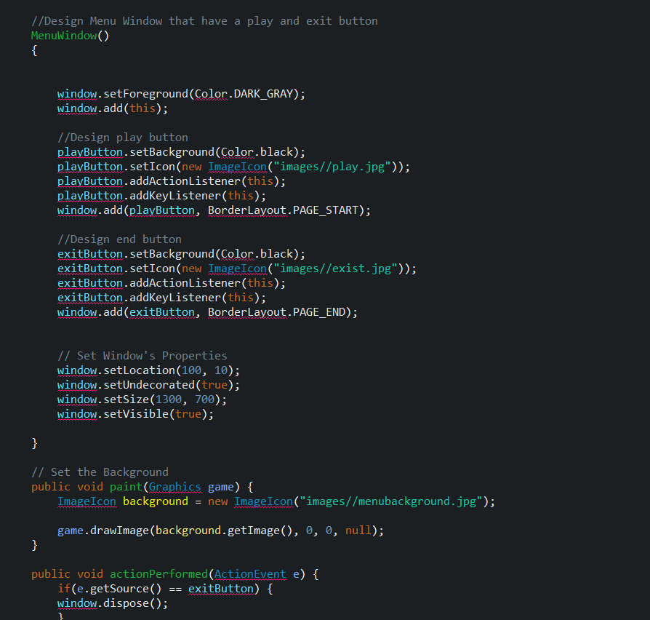
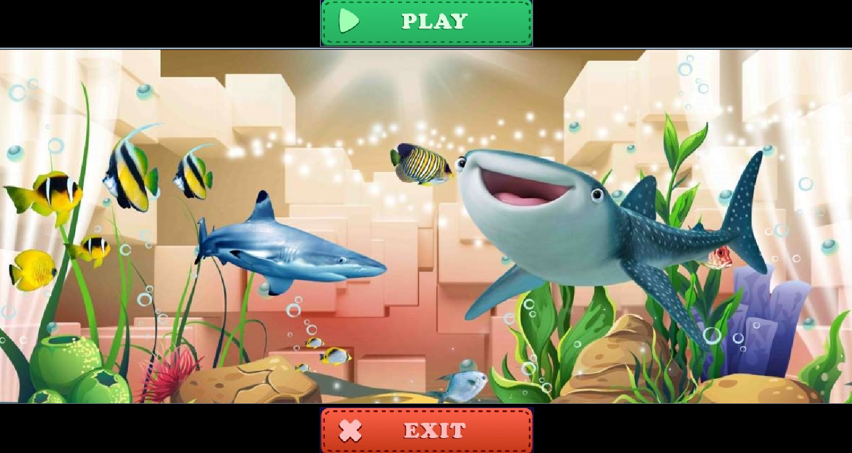
#MenuWindow
Class create a window that have play and exit button

Slide 16
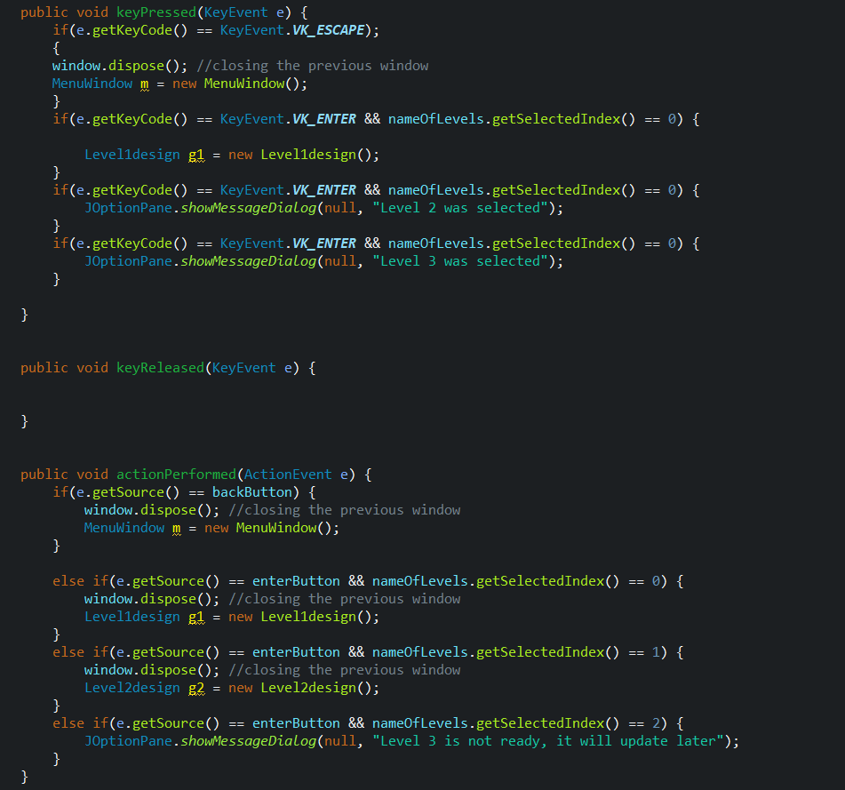
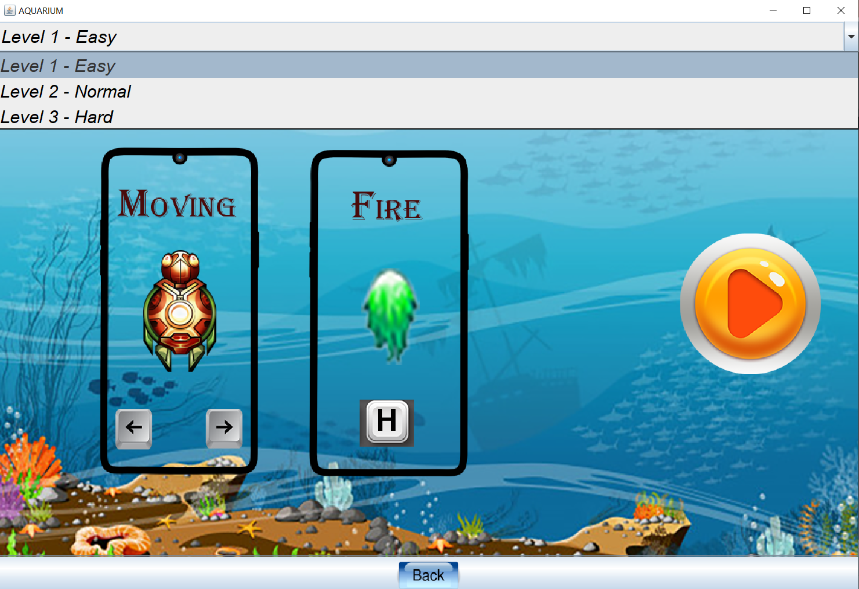
#PlayWindow
create a window that the user can select the level to start game.
Make sure the window close at the right time.

Slide 17
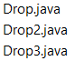
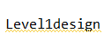
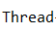
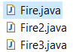
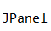
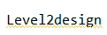
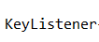
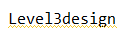
Interface

Slide 18


